Slide 1
Vision Vanguards
Harmonizing Pixels and Pitches: A Computer Vision-Enhanced Karaoke Experience
Notes:
Steph ~5-10sec

Slide 2
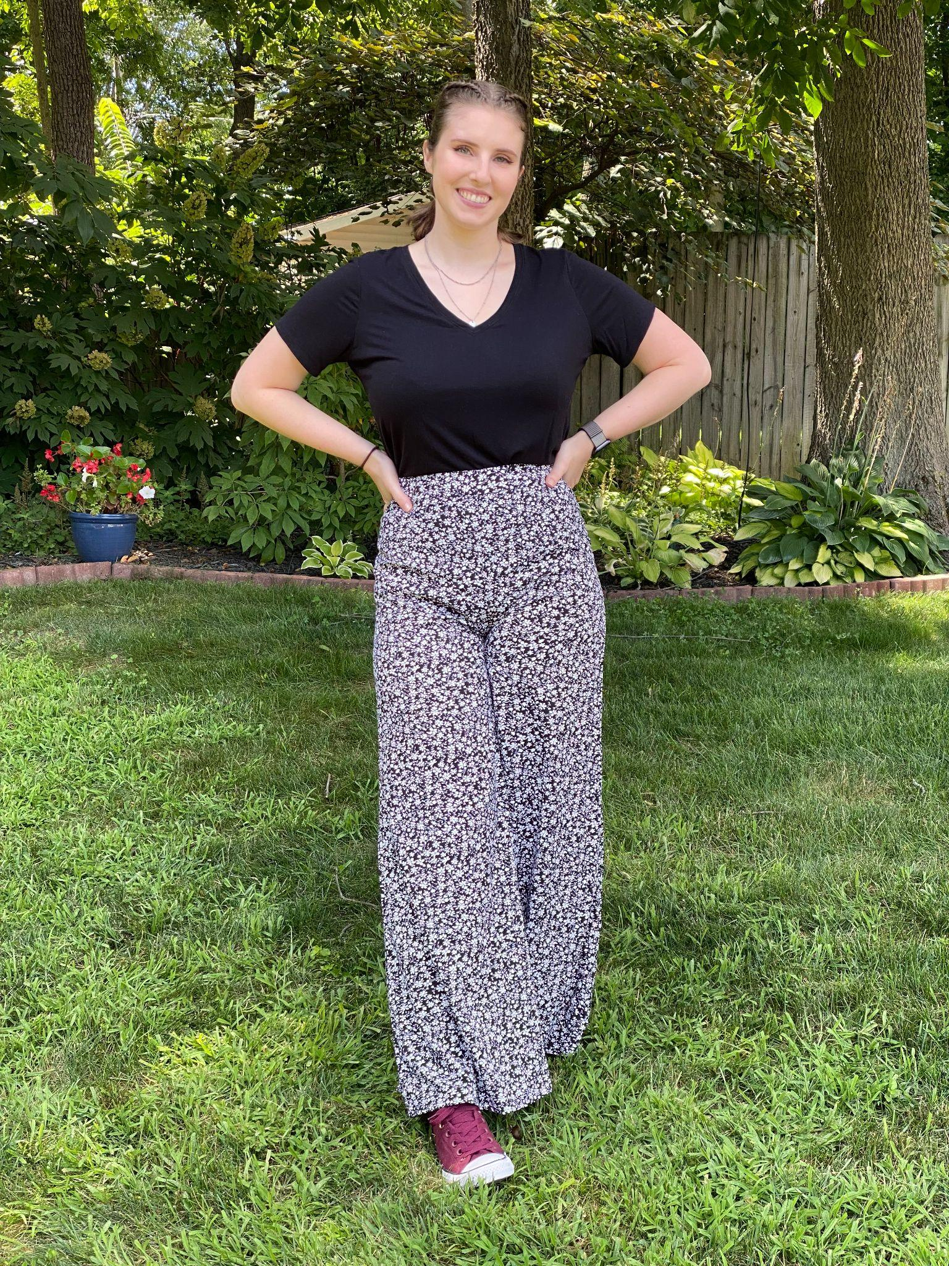
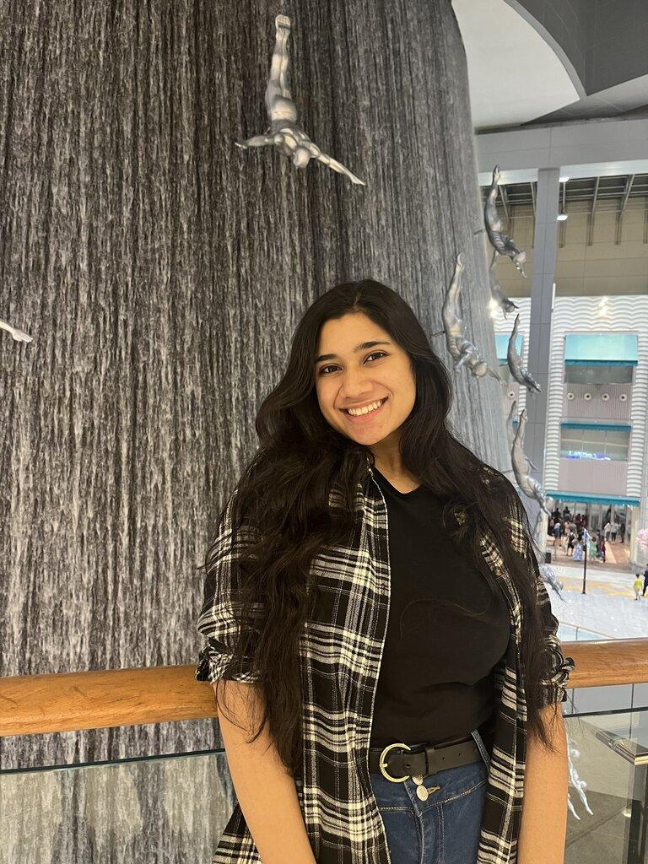
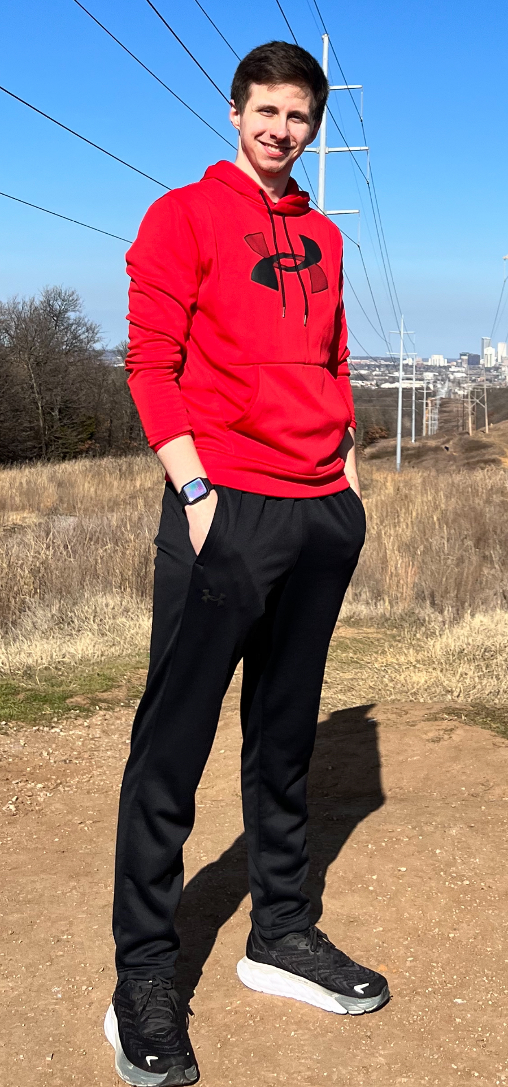
Introducing the Team
Stephanie Mullins
Athulya Ganesh
Rob Kelly
Notes:
All ~20-30sec

Slide 3
Abstract
Vision Vanguards aims to develop an integrated karaoke and movement web application, combining computer vision and audio processing technologies. The project involves implementing gesture and full-body skeletal tracking, alongside audio processing for lyrical pitch accuracy. The team has completed initial research, environment setup, and technology selection for the web interface. The envisioned outcome includes a fully functional platform with accurate scoring for singing and dance movements, a comprehensive lyrics module, and user management features. The project's success relies on seamless execution of key tasks, including technology implementation and interface optimization.
Notes:
Rob 45sec-1min

Slide 4
User Stories
As a casual singer, I want to visit the website, pick a song, and use only video scoring to have a lighthearted and entertaining karaoke experience without worrying about my singing skills.
As a song enthusiast, I want to access the app, use both video and audio scoring, and choose from a wide range of songs from the database to challenge myself and have fun with friends.
As a shy performer, I want to use the app in audio scoring mode, follow along with the lyrics displayed, and improve my singing skills privately while enjoying the music.
Notes:
Athulya

Slide 5
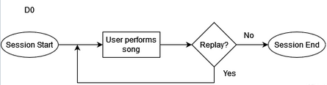
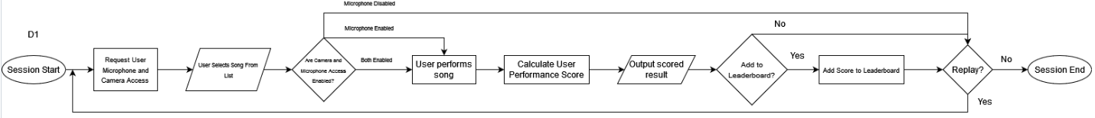
Design Diagrams
Notes:
Steph

Slide 6
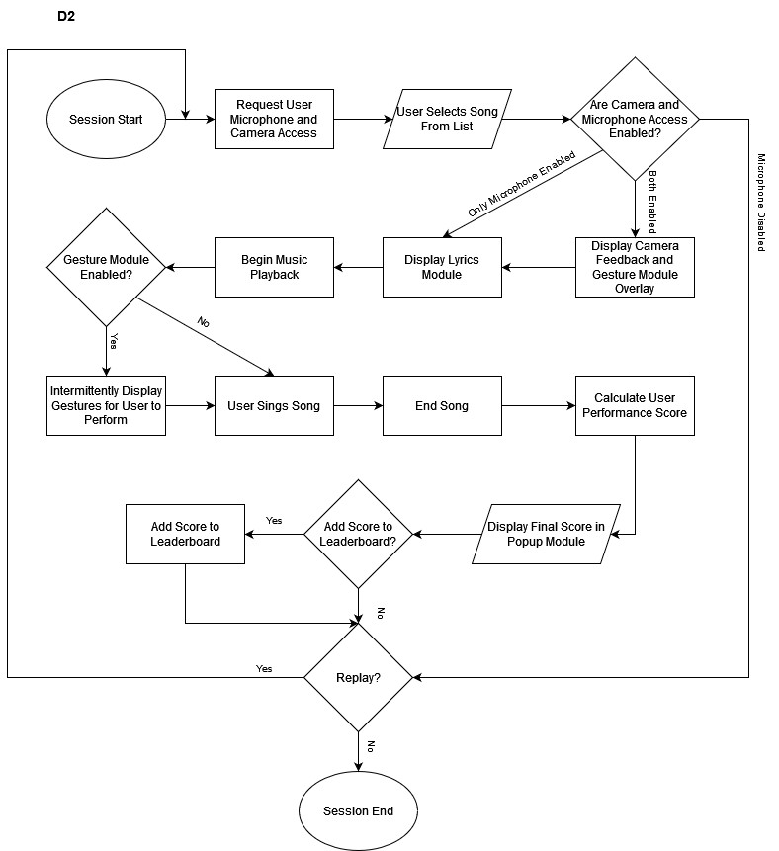
Design Diagrams (cont.)
Notes:
Steph

Slide 7
Project Constraints
Economic Constraints
Budgetary Limitations
Scalability and Maintenance Costs
Economic Impact
Ethical Constraints
User Engagement and Well-Being
Content and Intellectual Property Rights
Security Constraints
Data Security and Privacy
Malware and Cybersecurity Threats
Ethical Diversity and Cultural Constraints
Support Diverse Range of Vocal Styles and Pitches
Legal Constraints
Copyright Law Compliance
Professional Constraints
Lack of Computer Vision Course
Notes:
Rob

Slide 8
Expected End-of-Term Results
Computer Vision:
Finished researching and finished setting up an environment
Finished gesture recognition
Starting full body still images skeletal detection
Audio Processing:
Finished researching
Implemented selected audio processing library
Web Interface:
Figured out technology selection and UI design
Finished environment setup
Finished setting up web app skeleton and database
Notes:
Athulya

Slide 9
Division of Labor
Computer Vision Tasks:
Research technologies
Implement gesture tracking
Implement skeletal tracking
Implement skeletal tracking correctness
Audio Processing Tasks:
Research technologies and methods
Implement lyrical pitch accuracy features
Compute composite accuracy algorithm
Web Interface Tasks:
Research technologies
Setup environment and app
Performance interfaces
Lyrics module
Leaderboard and user management
All developers will work mainly on their section but will also do some work on the other sections.
Athulya Ganesh - Lead web interface developer.
Stephanie Mullins - Lead Computer Vision developer.
Rob Kelly - Lead audio processing developer.
Notes:
Steph

Slide 10
Expected Demo at Expo
Vision Vanguards plans to have a fully functional web application that combines karaoke with movement. This entails:
Completed website design and functionality
Audio and lyrics fully working
Dance movements and detection fully working
Dance and singing scored accurately
At the demo, there will be songs that the user can pick from to sing and dance to then get scored at the end depending on how well they followed the audio and dance movements that are given.
Notes:
Rob

